Slide 1
CSI ZG515/ SS ZG515 Data Warehousing
Swarna Chaudhary
Assistant Prof.

Slide 2
Advanced Dimensional Modelling

Slide 3
Lecture Objectives
Changing dimensions
Mini-dimensions and outriggers
Time dimension
Enterprise bus architecture
Bridge, role-playing dimensions, factless fact tables

Slide 4
Changing Dimensions
Slowly Changing Dimensions
Rapidly Changing Dimensions
Small Dimensions
Monster Dimensions

Slide 5
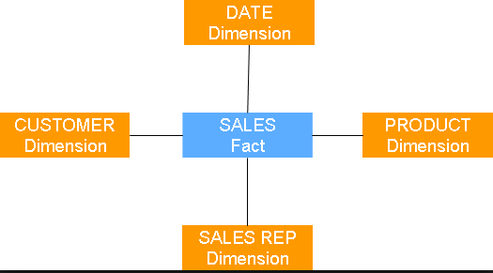
Impact of the changes

Slide 6
Slowly Changing Dimensions (SCDs)
Type I Change (overwrite)
Type II Change (new record)
Type III Change (new attribute)
Hybrid Approach

Slide 7
Slowly Changing Dimensions
Type I Change
Overwrite Old Value
Used in cases where old values have no significance
Where old values need to be discarded
Mainly used for correction
For Example, Spelling mistake
Example
Sam
1234567 | Same | Paul | bangalore | 7644807 | NDA123

Slide 8
Slowly Changing Dimensions
Type I Change
Fast & Easy to implement
Attribute value always reflect the latest assignment
No history of prior attribute values
The key of this dimension table or any other values are not affected.
In DW environment, can we afford to do that?
NO!!!

Slide 9
Slowly Changing Dimensions
Type I Change: PROBLEMS
Before the change:
SK Employee_Name Employee-dept NK
After the change:
12345 | Sam | Technical | 12AB02
12345 | Sam | HR | 12AB02
History of attribute changes is lost
Aggregates over department have to be rebuilt

Slide 10
Slowly Changing Dimensions
Type II Change
Add a dimension row
Keeps track of history
Usually relate to true changes in source
Used when we need to preserve history in the DWH.

Slide 11
Slowly Changing Dimensions
Type II Change: Examples
Fact Table Dimension Table
123456
….
123456
123456
Sam
Paul
Single
NDA123
123456
….
122332
122332
Sam
Paul
Married
NDA123
122332
…..

Slide 12
Slowly Changing Dimensions
Type II Change: Examples
Before Change
SK Product Department NK
12345 | Intellikidz1 | Education | ABC922Z
After Change
12345 | Intellikidz1 | Education | ABC922Z
12467 | Intellikidz1 | Strategy | ABC922Z
Adding the following columns help:
Row Effective date
Row Expiration date
Current Row indicator

Slide 13
Time-stamped Dimension
Time-stamped dimensions are used when it is necessary to support point-in-time analysis of dimension values, irrespective of associated facts.
• Easily order a chronological history of changes
• Quickly select dimension rows that were in effect for a particular date
• Easily identify the dimension rows currently in effect

Slide 14
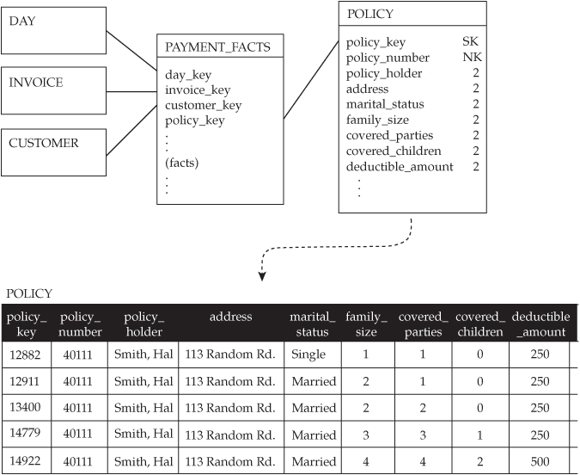
Point-in-Time Status of a Dimension
Type 2 Not Sufficient to provide point-in time analysis
For example,
The insurance company wants to understand what each policy looked like at any given point in time.
users might want to know how many policy holders were married versus how many were single on a particular date
Source: Star Schema: The Complete Ref., By Adamson

Slide 15
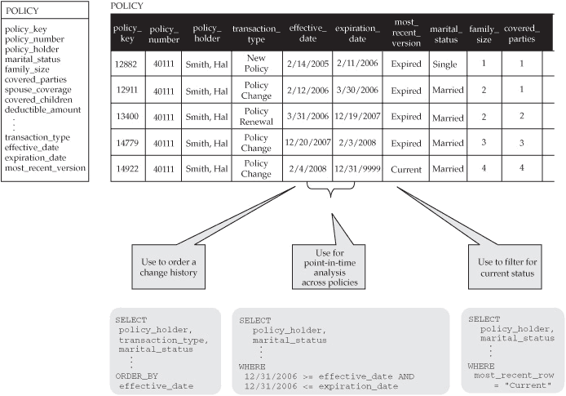
Solution: Time-Stamped Dimension
Source: Star Schema: The Complete Ref., By Adamson

Slide 16
Slowly Changing Dimensions
Type II Change: Implementation
The steps:
Add a new dimension table row with the new value of the changed attribute
An effective date will be included in the dimension table
There are no changes to the original row in the dimension table
The key of the original row is not affected
The new row is inserted with a new surrogate key

Slide 17
Slowly Changing Dimensions
Type II Change: Advantages
Automatically partitions history in the fact table
Tracks as many dimension changes as required
No need to rebuild aggregates

Slide 18
Slowly Changing Dimensions
Type II Change: Disadvantages
Dimension table can become big
Does not allow association of the new attribute value with old fact history & vice-versa
When we constraint on Dept=Strategy, we will not see Intellikidz1 facts from before the change date

Slide 19
Slowly Changing Dimensions
Type III Change:
Add a dimension column
Alternate Reality
Both current & prior values can be regarded as true at the same time
New and historical fact data can be seen either with the new or prior attribute values
Not used very often

Slide 20
Slowly Changing Dimensions
Type III Change: Example
SK Product Department NK
12345 | Intellikidz1 | Education | ABC922Z
SK Product Old_Dept New_Dept NK
12345 | Intellikidz1 | Education | Strategy | ABC922Z

Slide 21
Slowly Changing Dimensions
Type III Change: Problems
Good for handling predictable changes
Can lead to lot of wastage of space
Myriad of unpredictable changes
Cannot track the impact of numerous intermediate attribute values

Slide 22
Monster Dimension
Customer dimensions can be very wide
- Dozens or hundreds of attributes
Customer dimensions can be very large
- Tens of millions of rows in some warehouses
- Sometimes includes prospects as well as actual customers
Size can lead to performance challenges
- Negatively impact browsing and query performance
- type 2 add more rows to a dimension that already has millions of rows

Slide 23
Mini-Dimensions
Single technique to handle browsing-performance & change tracking problems
Separate out frequently used or frequently changing attributes into a separate dimension, called mini-dimension

Slide 24
Mini-Dimensions
Separate out a package of demographic attributes into a demographic mini-dimension
Age, marital status, no. of children, income level, etc.
One row in mini-dimension for each unique combination of these attributes

Slide 25
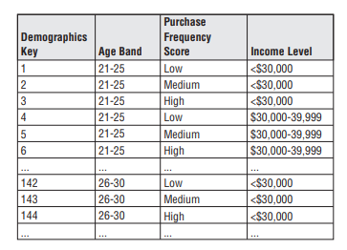
Mini-Dimensions
Mini-dimension sample rows
Figure Taken from Kimball’s book – The DW toolkit, 3e

Slide 26
Mini-Dimensions
Mini-dimension can not be itself allowed to grow very large (due to discretization)
5 demographic attributes
Each attribute can take 10 distinct values
How many rows in mini-dimension?

Slide 27
Creating Mini-Dimensions
Include foreign keys to both customer dimension & mini-dimension in fact table

Slide 28
Mini-Dimension Example
Customer key
Last name
First name
…
Customer dimension
Customer key
Last name
First name
…
Age
Gender
Income level
…
Age
Gender
Income level
A new dimension is created

Slide 29
Mini-dimension Example
Fact table
Customer key
Last name
First name
…
Dimensions
Customer key
Demographics key
Other keys
facts
Demographics key
Age
Gender
Income level
Demographics minidimension

Slide 30
Mini-Dimensions
Advantages
- History preserved without space blow-up
- FT captures historical record of attribute values
- Mini-dimension has small no. of rows
- # of unique combinations of MD attributes is small
- Consequence of discretization
- 5 attributes with 10 possible values has 100000 rows
- Limit no. of attributes in a single MD
- Improves performance for queries that use MD
- Atleast those queries that don’t use main customer dim.

Slide 31
Mini-Dimensions
Disadvantages
- Fact table width increases
- Due to increase in no. of dimension foreign keys
- Information lost due to discretization
- Less detail is available
- Impractical to change bucket/band boundaries
- Additional tables introduced
- Users must remember which attributes are in mini-dimension vs. main customer dimension

Slide 32
Junk Dimensions
A Junk dimension is a dimension that consists of attributes that don’t belong in any of the other dimension tables we’ve defined.
Usually, these fields are flag fields (TRUE/FALSE, 0,-1) or low cardinality (few distinct field values).
Examples might be IsActive (T/F), IsCovered (T/F), IsEligible (T/F), Status (Open/Closed/Suspended), color.
The idea is we would create a table that contains all the unique combinations of these fields.
The Junk dimension is then treated like any other dimension and used in the Fact table to give additional context to our measures.

Slide 33
Outrigger Tables
A dimension can contain a reference to another dimension table. For instance, a bank account dimension can reference a separate dimension representing the date the account was opened. These secondary dimension references are called outrigger dimensions. Outrigger dimensions are permissible, but should be used sparingly.
Limited normalization of large dimension table to save space
Identify attribute sets with these properties:
- Highly correlated
- Different grain than the dimension
(# of customers)
- Change in unison

Slide 34
Outriggers
Example:
A set of data from an external data provider consisting of 150 demographic & socioeconomic attributes regarding the customer’s district of residence
Data for all customers residing in a particular district is identical
Instead of repeating this large block of data for all customers, we model it as an outrigger

Slide 35
Outriggers
How To:
Follow these steps for each attribute set:
Create a separate “outrigger dimension” for each attribute set
Remove the attributes from the customer dimension
Replace with a foreign key to the outrigger table
No foreign key from fact row to outrigger
- Outrigger attributes indirectly associated with facts via customer dimension

Slide 36
Outriggers
Advantages:
Space savings
- Customer dimension table becomes narrower
- Outrigger table has relatively few rows
- One copy per district vs. one copy per customer
Disadvantages:
Additional tables introduced
- Accessing outrigger attributes requires an extra join
- Users must remember which attributes are in outrigger vs. main customer dimension
- Creating a view can solve this problem

Slide 37
Outriggers vs. Mini-Dimensions
Customer Dimension
Customer Dimension
Fact
Fact
Outrigger
Mini-dimension

Slide 38
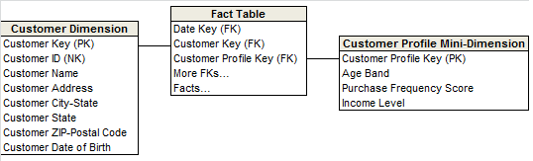
Type 4: Add a Mini-dimension
Figure Taken from Kimball’s book – The DW toolkit, 3e

Slide 39
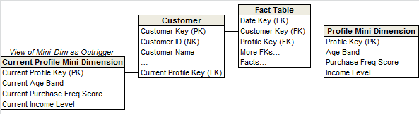
Type 5: Mini-dimension & Type 1 Outrigger
4+1=5!!
Type 4 mini-dimension with type 1 outrigger
Both mini-dimension & outrigger exist
As per Kimball, “Type 5 builds on the type 4 mini-dimension by also embedding a current type 1 reference to the mini-dimension in the base dimension. This enables the currently-assigned mini- dimension attributes to be accessed along with the others in the base dimension without linking through a fact table.”
mini-dimension reference is overwritten using type 1, whenever there is any change in the current mini-dimension.
Figure Taken from Kimball’s book – The DW toolkit, 3e

Slide 40
Type 5: Mini-dimension & Type 1 Outrigger
Is used to accurately preserve historical attribute values, plus report historical facts according to current attribute values.
This enables the currently-assigned mini- dimension attributes to be accessed along with the others in the base dimension without linking through a fact table.
When to use?
When there is need to access the current values in the mini-dimension directly from the base table without joining a fact table.
Figure Taken from Kimball’s book – The DW toolkit, 3e

Slide 41
Type 5: Mini-dimension & Type 1 Outrigger
Why not implement it as Type 2 outrigger?
We would then be capturing volatile changes in the monster customer dimension
A problem that we set out to solve using Type 4!!
Figure Taken from Kimball’s book – The DW toolkit, 3e

Slide 42
Type 5: Mini-dimension & Type 1 Outrigger
Current profile count can be found out in the absence of FT metrics
Figure Taken from Kimball’s book – The DW toolkit, 3e

Slide 43
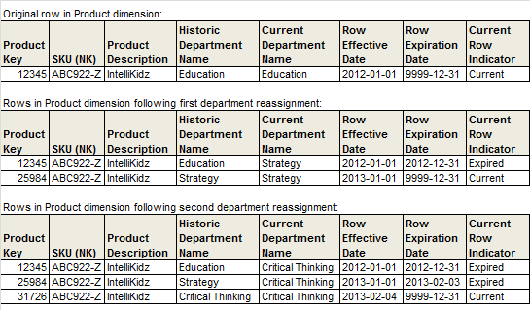
Type 6: Add Type 1 attributes to Type 2 dimension
Combines Type 1, 2, & 3!!
1+2+3=6 and also 1*2*3=6!!
Figure Taken from Kimball’s book – The DW toolkit, 3e

Slide 44
Type 7: Dual Type 1 & Type 2 dimensions
7 is just a number here!!
Is it feasible to support both the current & historic perspectives for 150 attributes in a large dimension table?
Enter Type 7 hybrid
Include the Natural Key as a FK in the FT along with the Surrogate Key for Type 2 tracking
If NK is unwieldy or ever reassigned, use a separate supernatural key instead
Figure Taken from Kimball’s book – The DW toolkit, 3e

Slide 45
Type 7: Dual Type 1 & Type 2 dimensions
With type 7, the fact table contains dual foreign keys for a given dimension: a surrogate key linked to the dimension table where type 2 attributes are tracked, plus the dimension’s durable supernatural key linked to the current row in the type 2 dimension to present current attribute values.
Type 7 delivers the same functionality as type 6, but it’s accomplished via dual keys instead of physically overwriting the current attributes with type 6.
Like the other hybrid approaches, the current dimension attributes should be distinctively labeled to minimize confusion.
Source: Kimball’s book – The DW toolkit, 3e

Slide 46
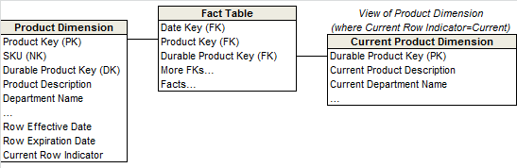
Type 7: Dual Type 1 & Type 2 dimensions
Figure Taken from Kimball’s book – The DW toolkit, 3e

Slide 47
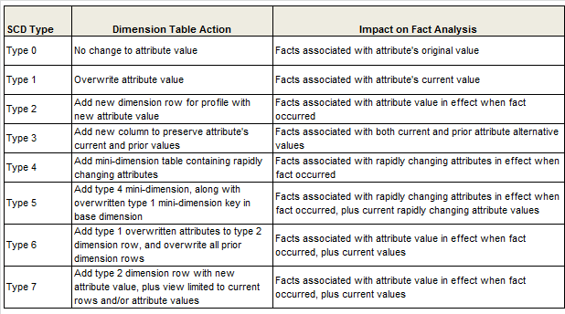
Summary: Type 1 to Type 7
Figure Taken from Kimball’s book – The DW toolkit, 3e

Slide 48
Time Dimension

Slide 49
Time Dimension
Time is a unique & powerful dimension in every DM & EDW
Time dimension is very special & should be treated differently from other dimensions
Example of a Star Schema
Fact table records daily orders received by a manufacturing company
Time dimension designates calendar days

Slide 50
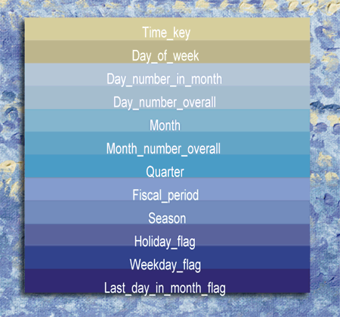
Time Dimension
Figure Taken from Kimball’s article

Slide 51
Data Warehouse Bus Architecture
Cannot built the enterprise data warehouse in one step.
Building isolated pieces will defeat consistency goal.
Need an architected incremental approach → data warehouse bus architecture.
By defining a standard bus interface for the data warehouse environment, separate data marts can be implemented by different groups at different times. The separate data marts can be plugged together and usefully coexist if they adhere to the standard.

Slide 52
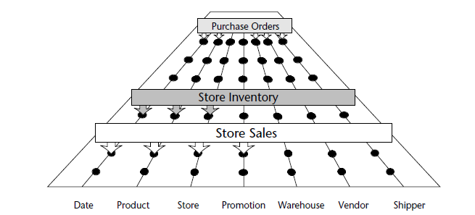
Data Warehouse Bus Architecture – Cont’d
During architecture phase, team designs a master suite of standardized dimensions and facts that have uniform interpretation across the enterprise.
Separate data marts are then developed adhering to this architecture.

Slide 53
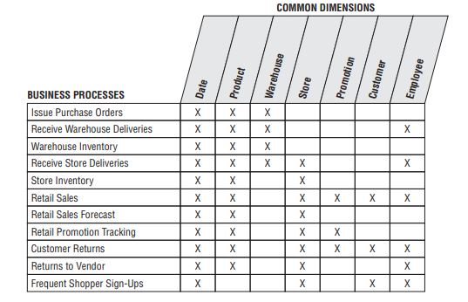
Data Warehouse Bus Matrix
The rows of the bus matrix correspond to business processes → data marts
Creating the DW bus matrix is a very important up-front deliverable of a DW implementation. The DW bus matrix is a hybrid resource: technical design tool, project management tool, and communication tool.

Slide 54
Conformed Dimensions
Conformed dimensions are:
identical, or
strict mathematical subsets of the most granular, detailed dimension.
Conformed dimensions have consistent
Dimension keys
Attribute column names
Attribute definitions
Attribute values
If two marts have dimensions (e.g., customer, product) that are not conformed, then they cannot be used together

Slide 55
Multivalued Dimension
occur when a fact table row may need to refer to more than one row in a dimension table.
What happens when a fact may be related to one or more instances of a dimension?
E.g. More than one salesperson can collaborate on an order
How does one design a dimensional model in such a situation?
The fact table cannot hold a foreign key reference to the salesrep table, since there may be more than one salesperson.

Slide 56
Multivalued Dimension : Solution
1 solution: Place more than one key value in the fact table.
This approach effectively flattens the complex relationship between fact and dimension
2nd solution: bridge the relationship between fact table and dimension table with a special table, called as bridge table.
This approach is more flexible in terms of the information it can capture and the kinds of reports it can produce.

Slide 57
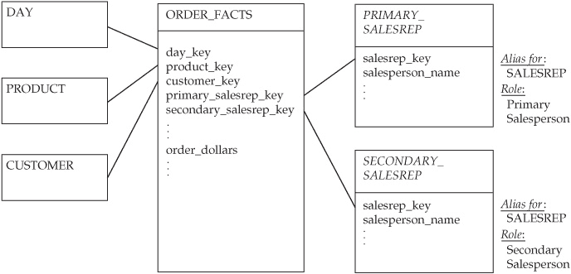
Multivalued Dimension : Solution
1st solution
Challenges:
Want to list all salespeople along with the total order_dollars in which they were involved?
Query the fact table twice, once for the primary salesperson, and again for secondary salesperson. Then, merge the result sets together.
It will be more complicated if the fact table allows for three, or more salesperson.
the solution only allows for a fixed number of relationships.
Source: STAR Schema by damson

Slide 58
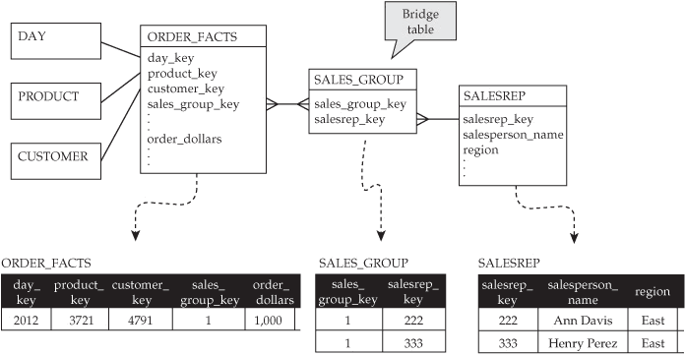
Multivalued Dimension : Solution
2nd solution: Bridge Table, group table that sits between the fact table and the dimension table.
A Table contains a group_key and a foreign key column referring to the dimension.
A row is added for each group member. If there are three members of the group, the group table will have three rows for that group.
Each row shares the same group_key.
The fact table and the bridge can be joined using the group_key
Source: STAR Schema by Adamson

Slide 59
Role Playing Dimension
A single dimension key might serve multiple purposes, or “roles” in a fact table
Example: an order might have an order date, a due date, a ship date, etc.
No need to create 3 versions of a Date dimension – just one, with 3 relationships
We cannot literally use a single date dimension
Create an illusion of 3 independent date dimensions by using view or aliases
Source: STAR Schema by Adamson

Slide 60
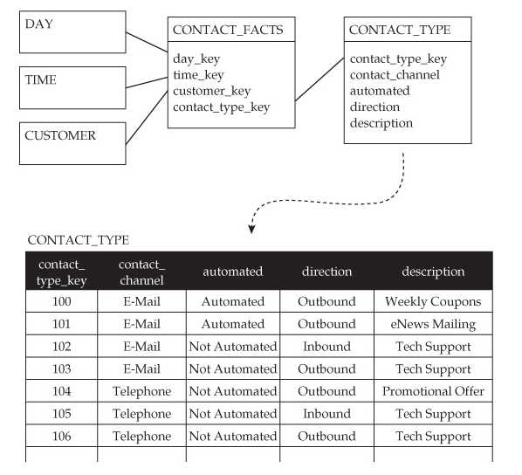
Factless Fact table
Special type of transactional fact table
Each row represents an “event”, intersection of dimensions
One can find out the # of instances where dimensions come together
it does support measurement of the business process.
It can be used to answer a wide variety of analytic questions, simply by counting rows in the fact table.
Source: STAR Schema by Adamson

Slide 61
Q & A

Slide 62
Thank You

